Slide 1
Predicting the severity of accidents

Slide 2
introduction
Car accident is one of the most critical life changing action.
Road traffic injuries are currently estimated to be the eighth leading cause of death across all age groups globally, and are predicted to become the seventh leading cause of death by 2030.
The Government and other related service organizations can take proper actions to prevent sever accidents and prepare resources which are needed to react adequately.
Machine Learning is the best choice to predict required info in real time regarding multi-factorial and sophisticated environment
Government agencies, healthcare service provider, and Travelers would be very interested in accurate prediction of severity.

Slide 3
Data acquisition and cleaning
Source: Traffic Records Group from Seattle.
Duplicate, highly similar or highly correlated features were dropped.
Others or Unknown are identified as missing values
Drop severity code missing values
For INATTENTIONIND, SPEEDING, PEDROWNOTGRNT feature, missing values are considered as “No” values
The missing values in other features are replaced by mean or mode values according to type of variable and suitable classes regarding severity code

Slide 4
severity
Location,Date
address type, junction type
inattention of driver, drugs or alcohol usage
weather condition, light condition
whether pedestrian right of way, speed, existing of parked car
where collusion type of collision
count of persons, pedestrians, vehicle, and bicycles involved

Slide 5
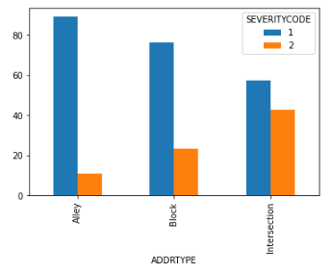
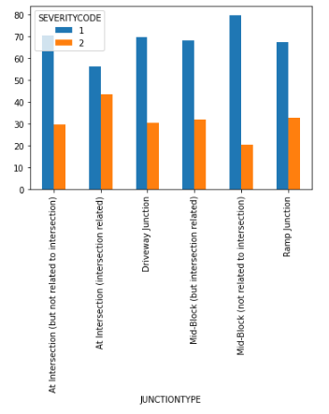
Address type & junction type
Severity was significantly different (chi square p<5%).

Slide 6
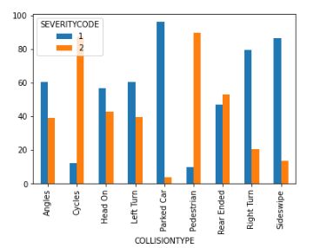
Collision Type
Severity was significantly different (chi square p<5%).

Slide 7
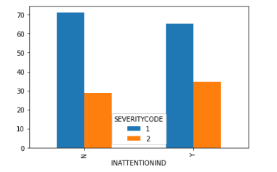
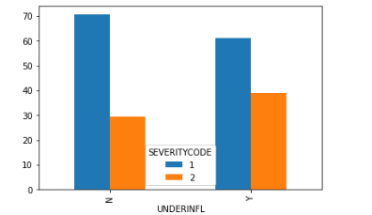
Inattention, Drugs, and alcoholism
Severity was significantly different (chi square p<5%).

Slide 8
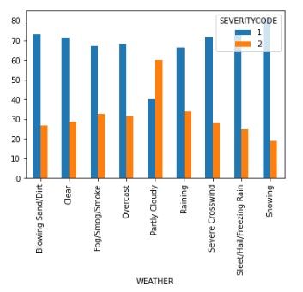
Weather
Severity was significantly different (chi square p<5%).

Slide 9
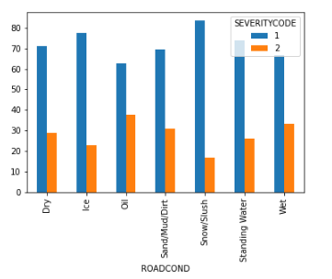
Road condition
Severity was significantly different (chi square p<5%).

Slide 10
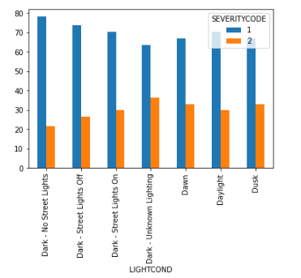
Light condition
Severity was significantly different (chi square p<5%).

Slide 11
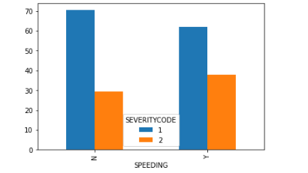
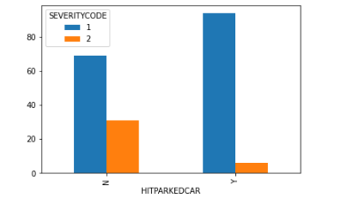
Speeding & Parked car
Severity was significantly different (chi square p<5%).

Slide 12
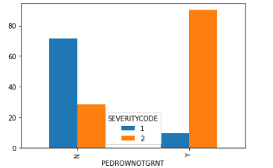
pedestrian right of way
Severity was significantly different (chi square p<5%).

Slide 13
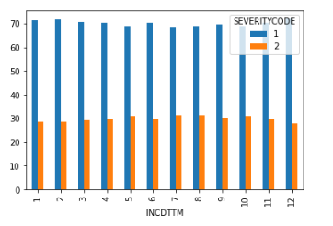
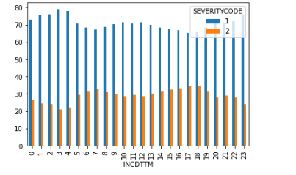
Date & Time
Severity was significantly different (chi square p<5%).
Month
Hour

Slide 14
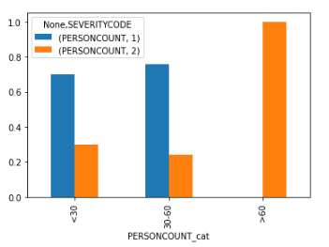
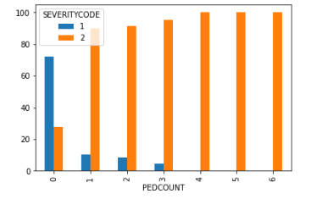
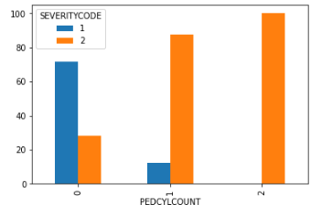
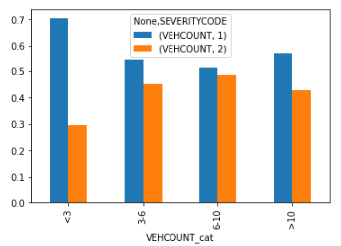
Person Count & pedestrians & bicycles & vehicles
Severity was significantly different (chi square p<5%).

Slide 15
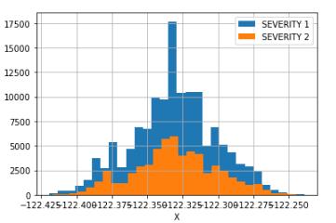
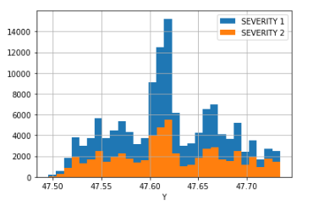
Location
Severity was significantly different (T test p<5%).

Slide 16
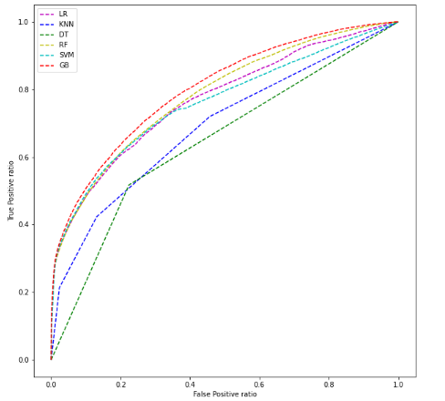
Predicting Models
 | LR | KNN | DT | RF | GB | SVM
Accuracy | 0.7847 | 0.7505 | 0.7110 | 0.7850 | 0.7911 | 0.7784
Log_loss | 0.4808 | 24.2034 | 9.9748 | 0.4828 | 0.4502 | 0.5179
Tp | 6715 | 7581 | 10313 | 8751 | 7320 | 5460
Tn | 43699 | 40638 | 35370 | 41681 | 43503 | 44550
Fp | 1319 | 4380 | 9648 | 3337 | 1515 | 468
Fn | 12510 | 11644 | 8912 | 10474 | 11905 | 13765
gradient boost classifier achieved best result (highest accuracy & lowest log_loss)

Slide 17
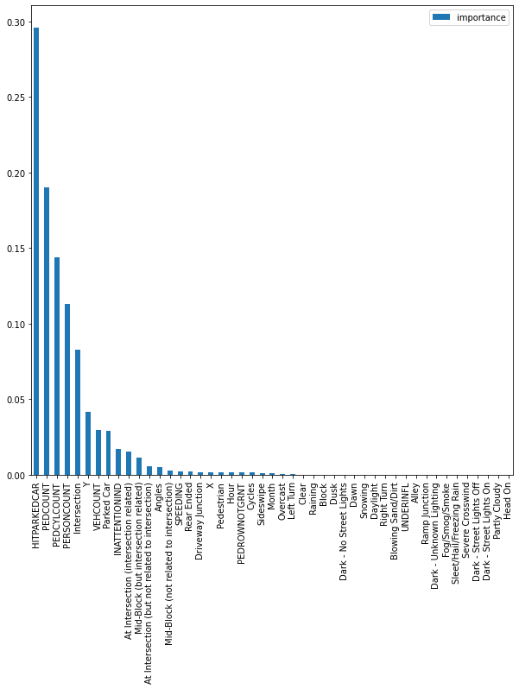
Risk Factors
Features, which is important in prediction process, is hitting parked car, number of persons involved (Person Count & pedestrians & bicycles), and intersection related accidents.

Slide 18
conclusion
Built model with acceptable accuracy to predict accident severity
very useful for helping Government agencies, healthcare service provider, and Traveler in many ways
Risk factors for sever accident :
hitting parked car
number of persons involved (Person Count & pedestrians & bicycles)
intersection related accidents

